Slide 1

Project Title -Car Market Trends Analysis with CarDekho Data
Student ID : STU6a5a433eac6fd1784300350
Student Name : Harshada Nanabhau Mali

Slide 2

PROBLEM STATEMENT
Analyze factors affecting used car selling prices.
Identify trends based on fuel type, transmission, seller type, year, and kilometres driven.

Slide 3
Project Description
The dataset contains 301 car records and 9 attributes, including selling price, fuel type, year, kilometres driven, and transmission. The project analyzes the used-car market and visualizes important trends.

Slide 4

WHO ARE THE END USERS?
Car buyers
Car sellers
Car dealers
Market analysts

Slide 5

Technology Used
  Python
  Pandas
  Matplotlib
  Seaborn

Slide 6
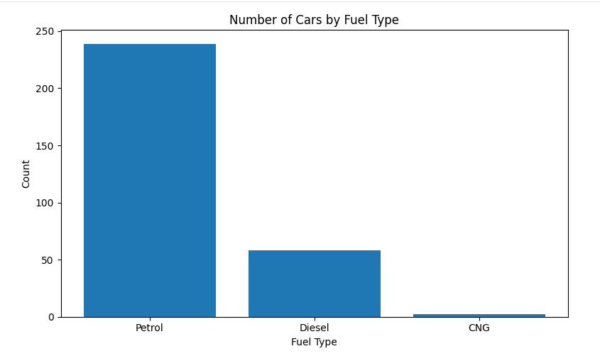
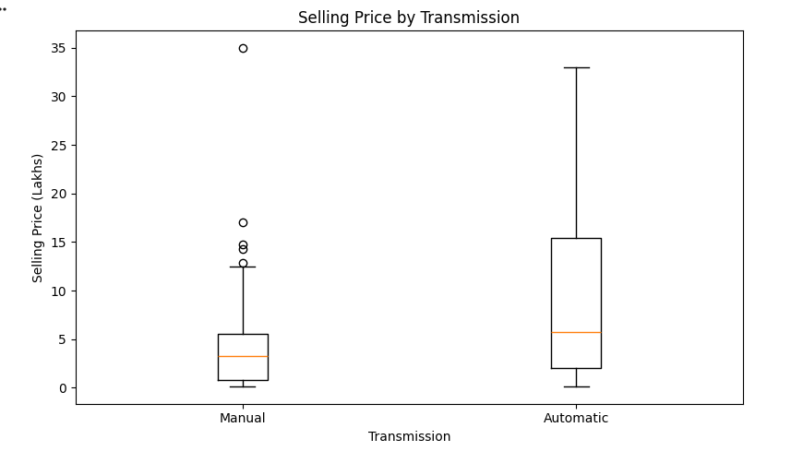
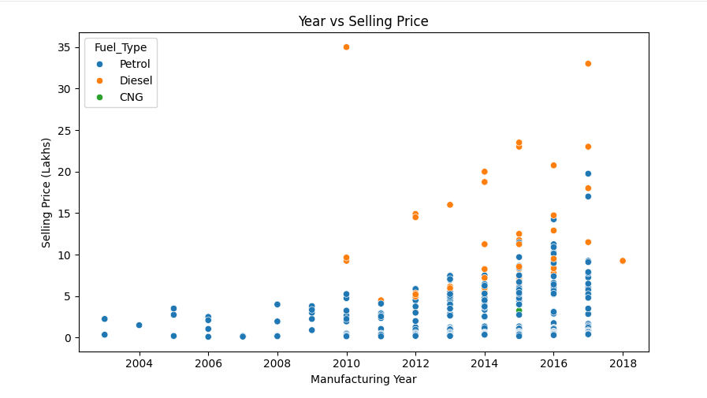
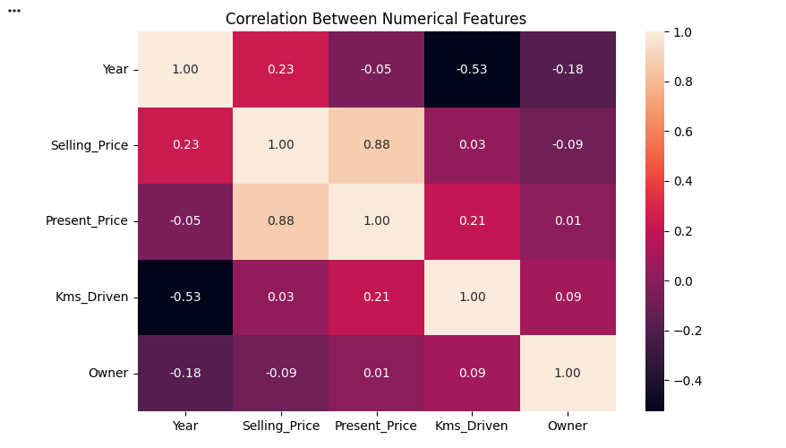
RESULTS
Demo Link

Slide 7
Thank you
.
.

